Slide 1

Big data tools in Health insurance firms
TEAM 1:
ABDUL WAHED, SANATH KUMAR, AND POOJA LAVETI

Slide 2

Introduction
A Health Care insurance business is having difficulty increasing revenue and understanding its clients, therefore it wants to use the Big Data Ecosystem to examine competitor firm data obtained from a variety of sources, including scraping and third-party sources. This study will assist them in tracking the behavior and condition of clients in order to create offers to encourage them to acquire insurance plans and also compute rewards to those consumers who have previously purchased policies, which will increase their earnings.

Slide 3

Proposed solution
The project's objective is to build data pipelines for the health insurance industry, which will enable the company to develop effective business plans to increase income by studying customer behavior and sending offers and royalties, respectively, to clients.

Slide 4
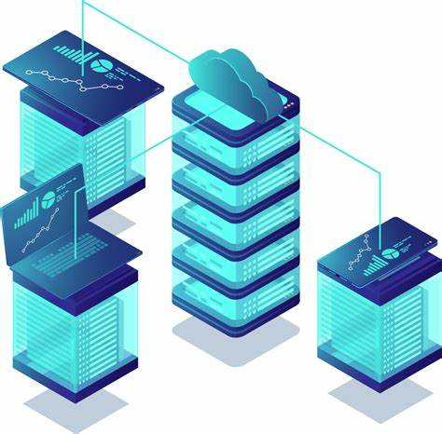
Dataset Description
We have used 7 different types of datasets like Disease, groups, claims, subscribers, hospitals, patient_records, and subgroup which contains all the information of patients and the type of diseases they are facing and the type of insurance they claimed, and also the details of which group it belongs.

Slide 5
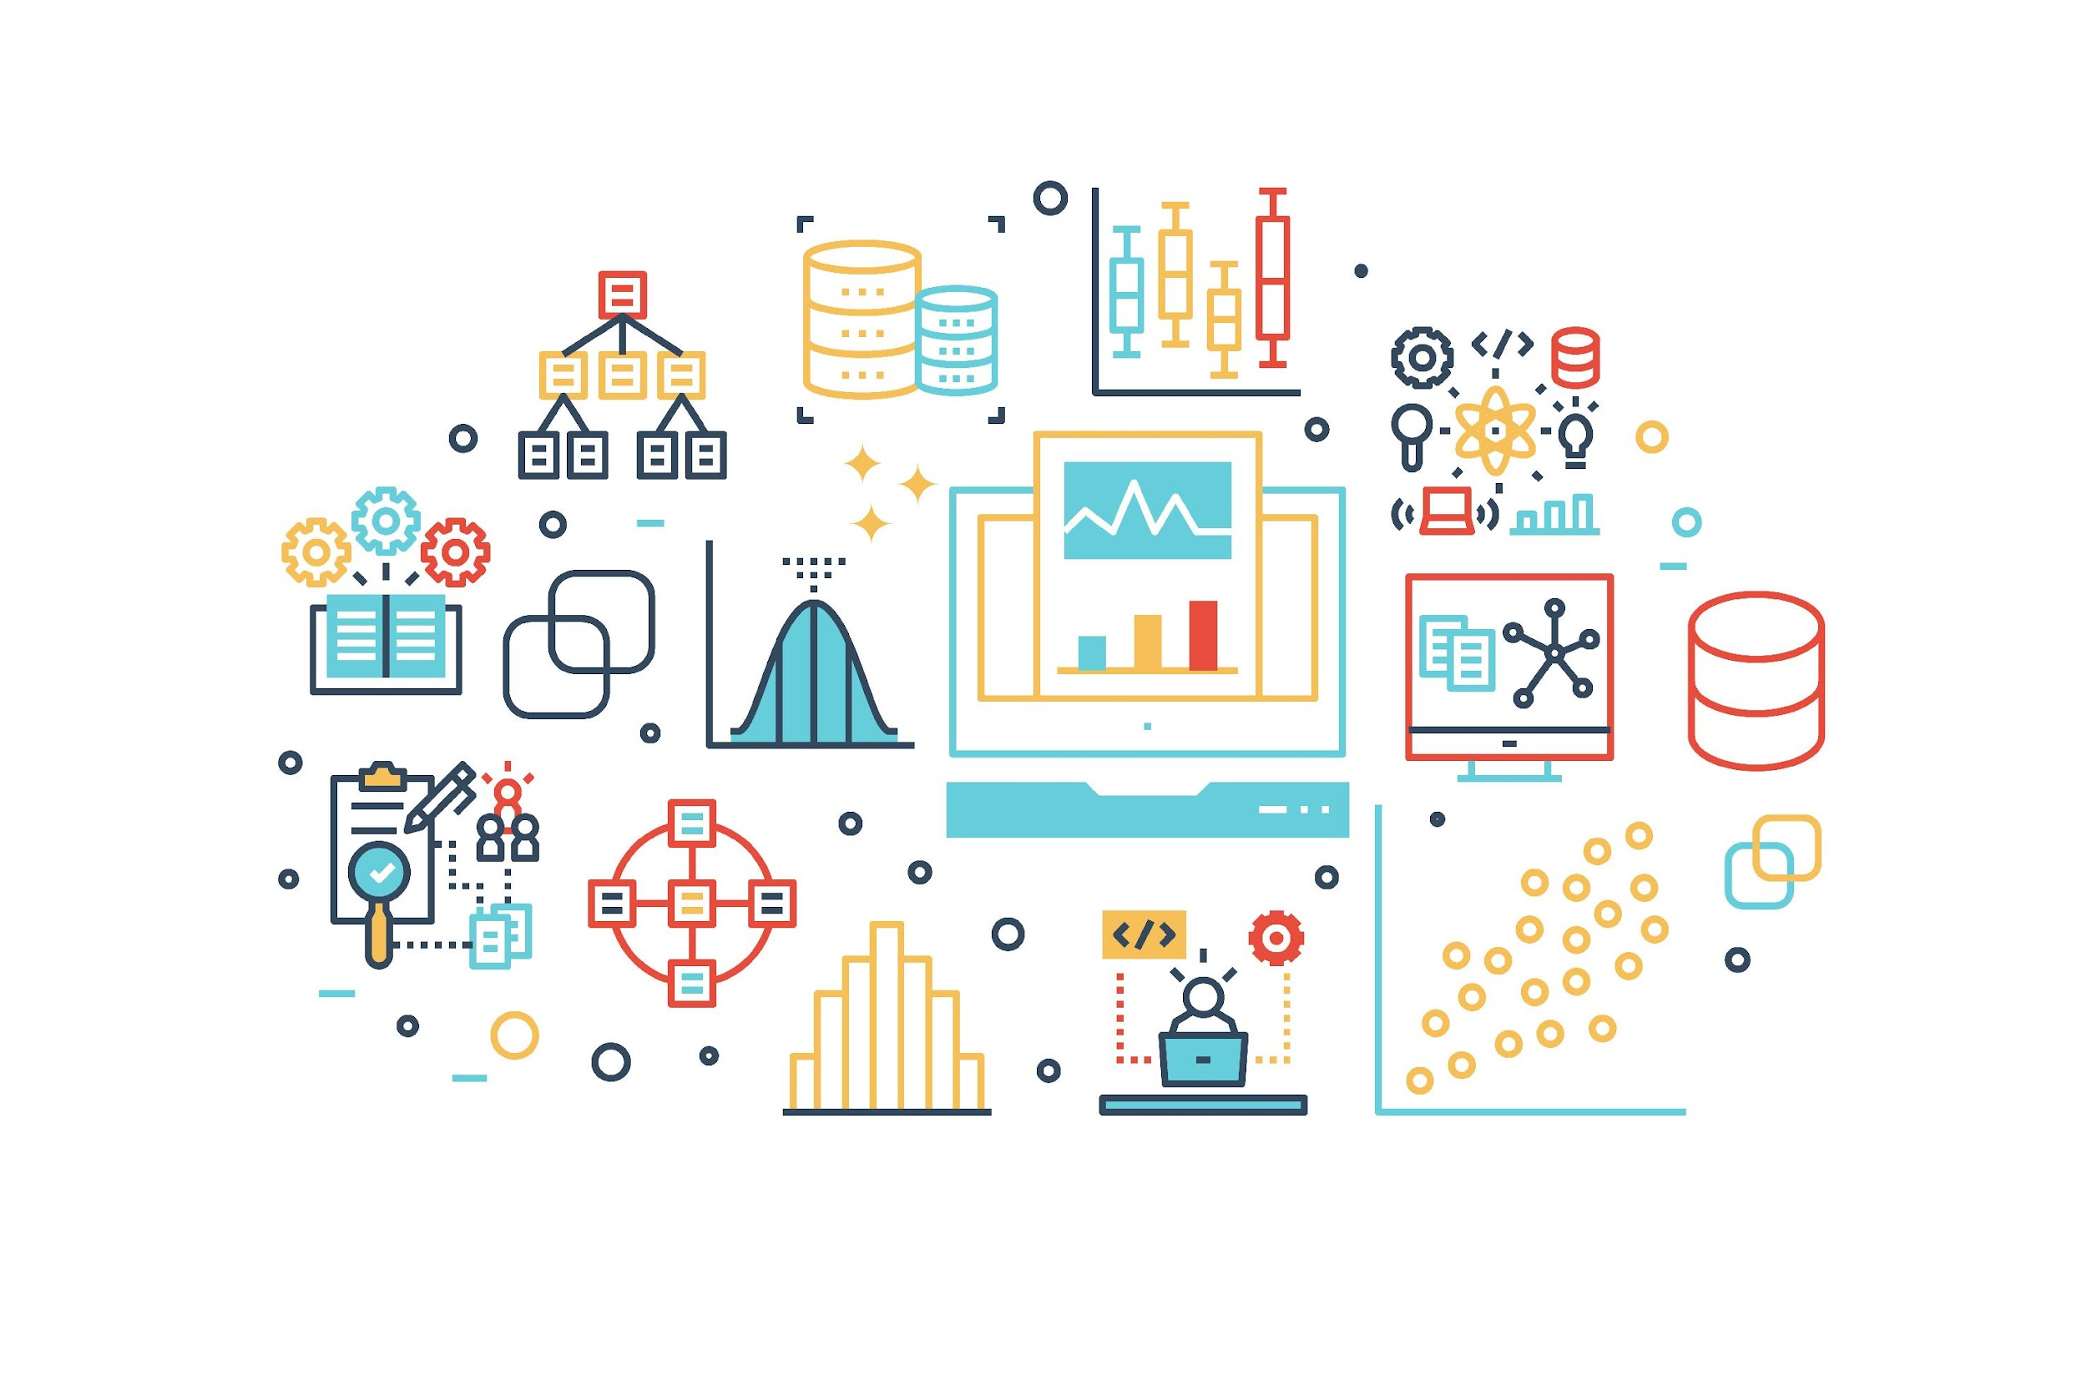
Data Analysis
Data analysis is the process of cleaning, changing, and processing raw data and extracting actionable, relevant information that helps businesses make informed decisions.
The procedure helps reduce the risks inherent in decision-making by providing useful insights and statistics, often presented in charts, images, tables, and graphs.
[3] Karin Kelly (2022, Nov 29).

Slide 6

Data Cleaning
Data cleaning is the process of fixing or removing incorrect, corrupted, incorrectly formatted, duplicate, or incomplete data within a dataset. When combining multiple data sources, there are many opportunities for data to be duplicated or mislabeled. If data is incorrect, outcomes and algorithms are unreliable, even though they may look correct. There is no one absolute way to prescribe the exact steps in the data cleaning process because the processes will vary from dataset to dataset.
[1] Tableau

Slide 7
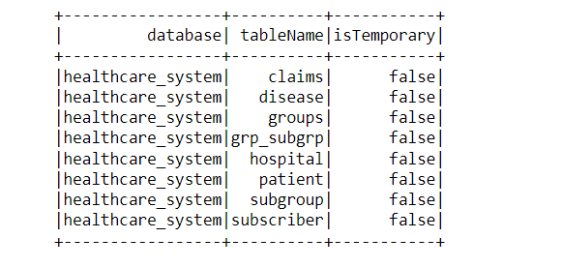
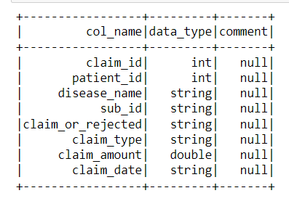
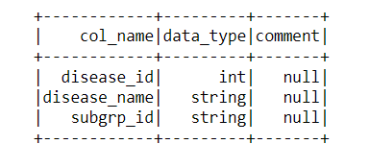
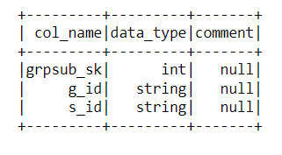
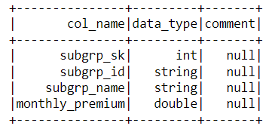
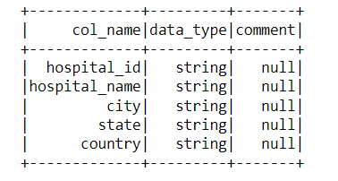
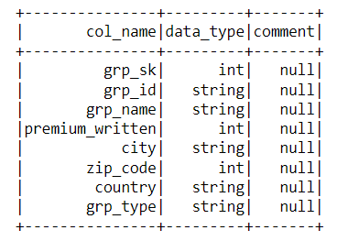
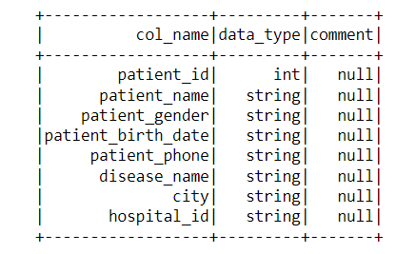
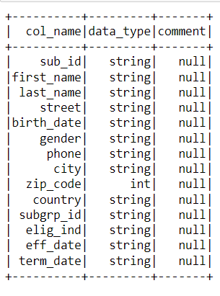
Tables and columns of the healthcare database.

Slide 8
Big Data Tools and Environment
Linux (Ubuntu 18.04)
Hadoop 2.7.2
Spark 2.0.2
Sqoop 1.4.7
python3

Slide 9
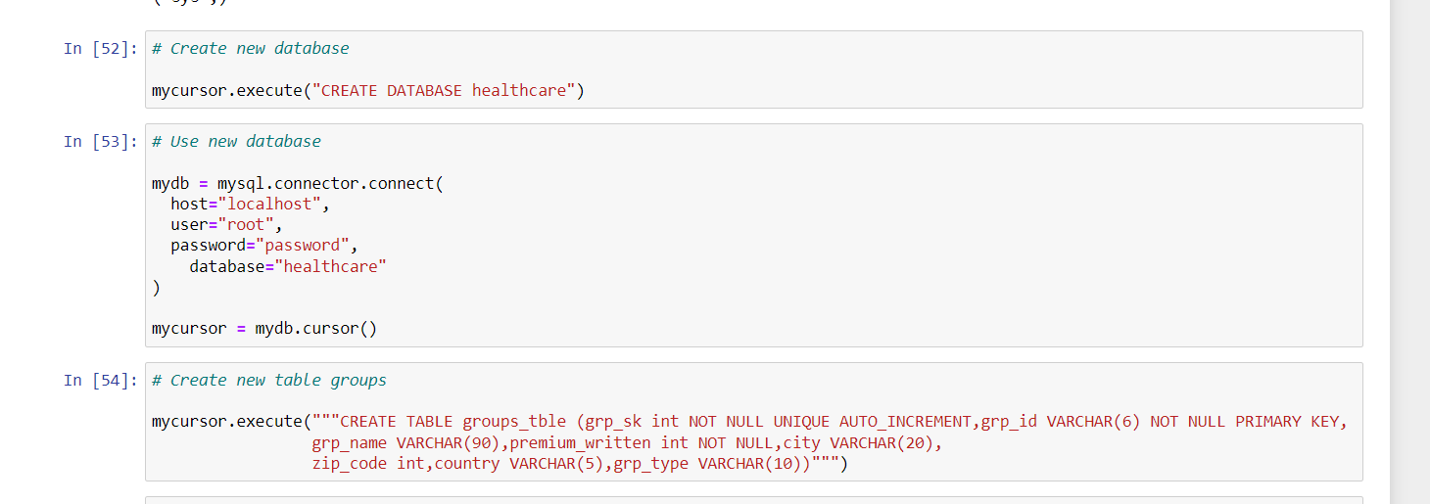
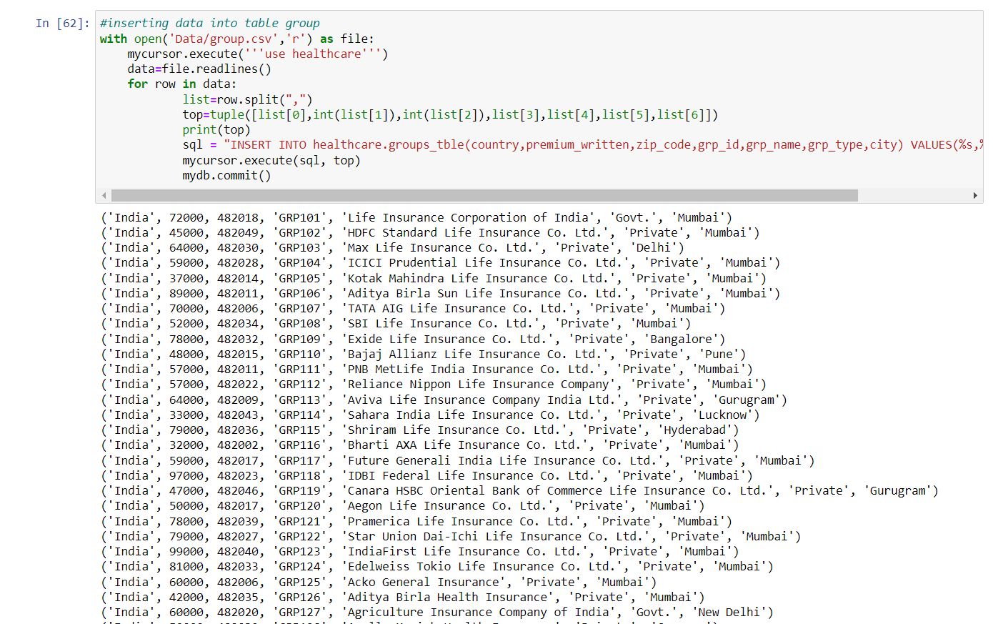
Database creation and Loading
Figure: (a)
Figure: (b)

Slide 10
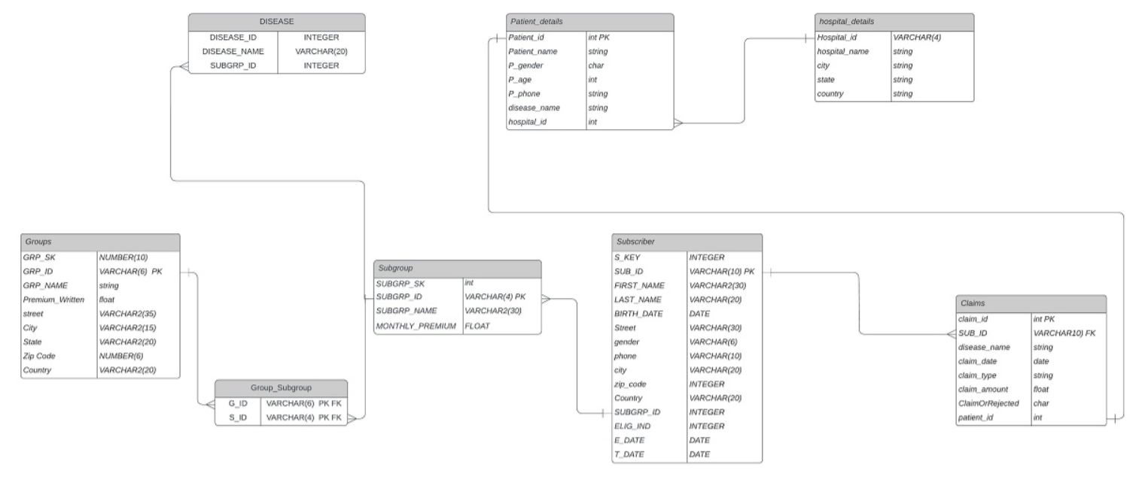
RDBMS Schema

Slide 11
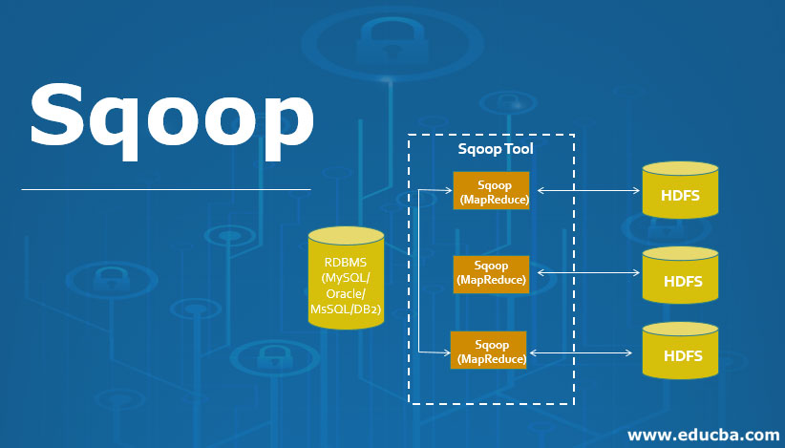

Sqoop and Hadoop
[4] Eduba, 2018

Slide 12
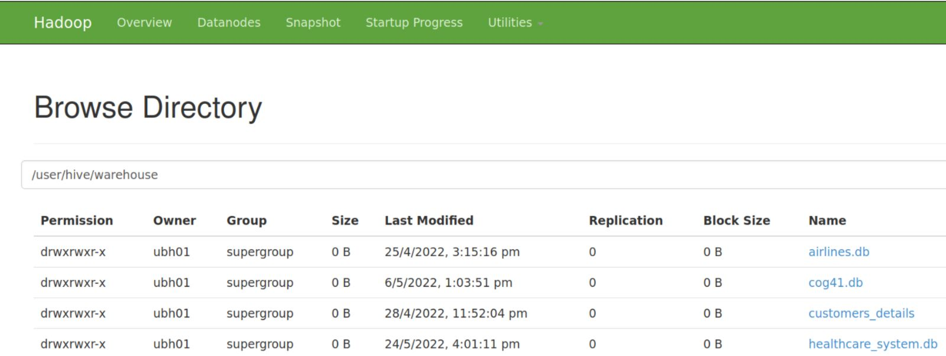
Hive Database

Slide 13
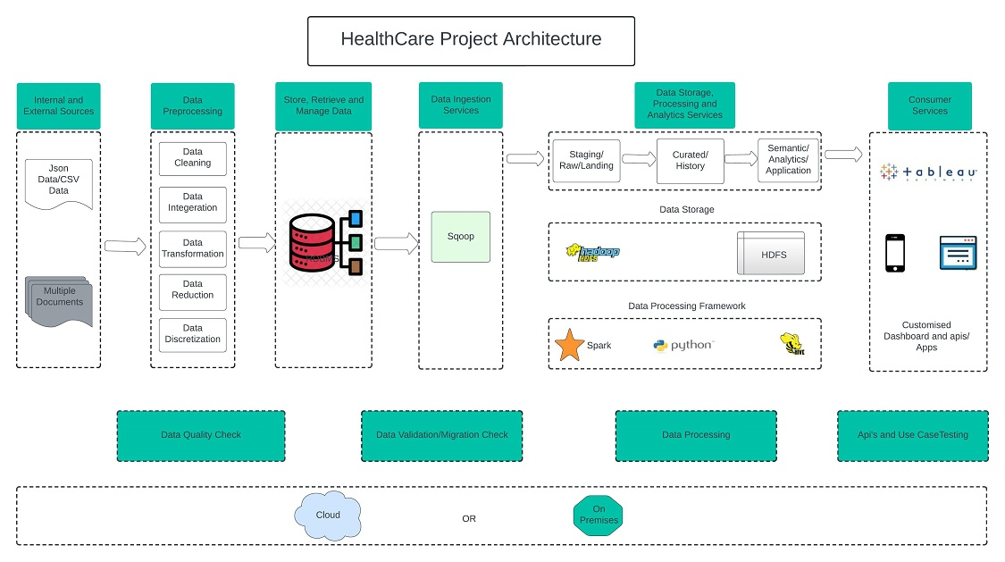
Big Data Stack Architecture Diagram

Slide 14

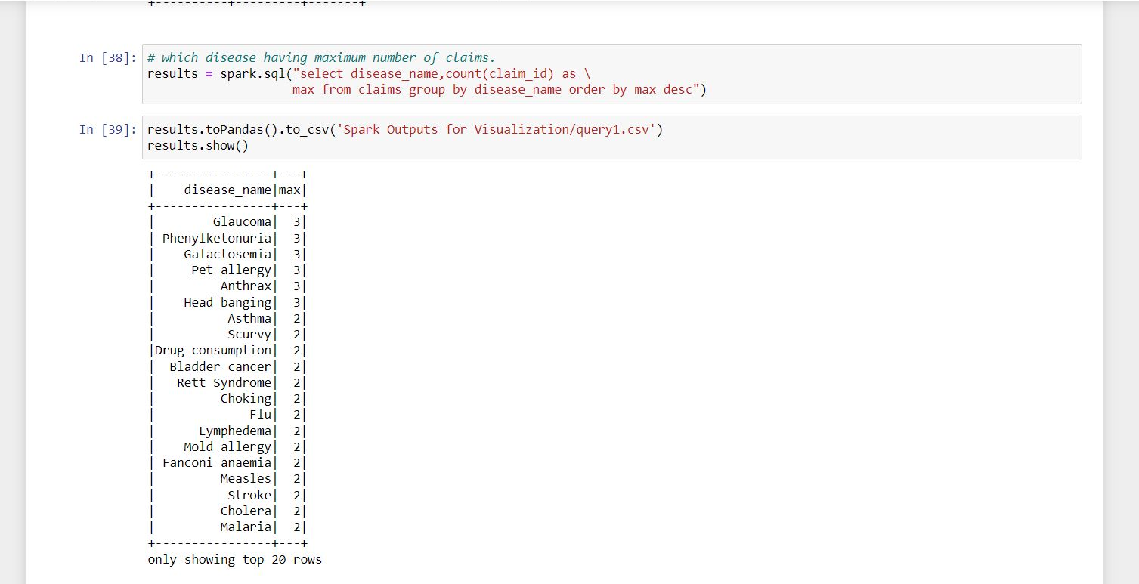
Data Visualization
Running a query in Spark SQL

Slide 15
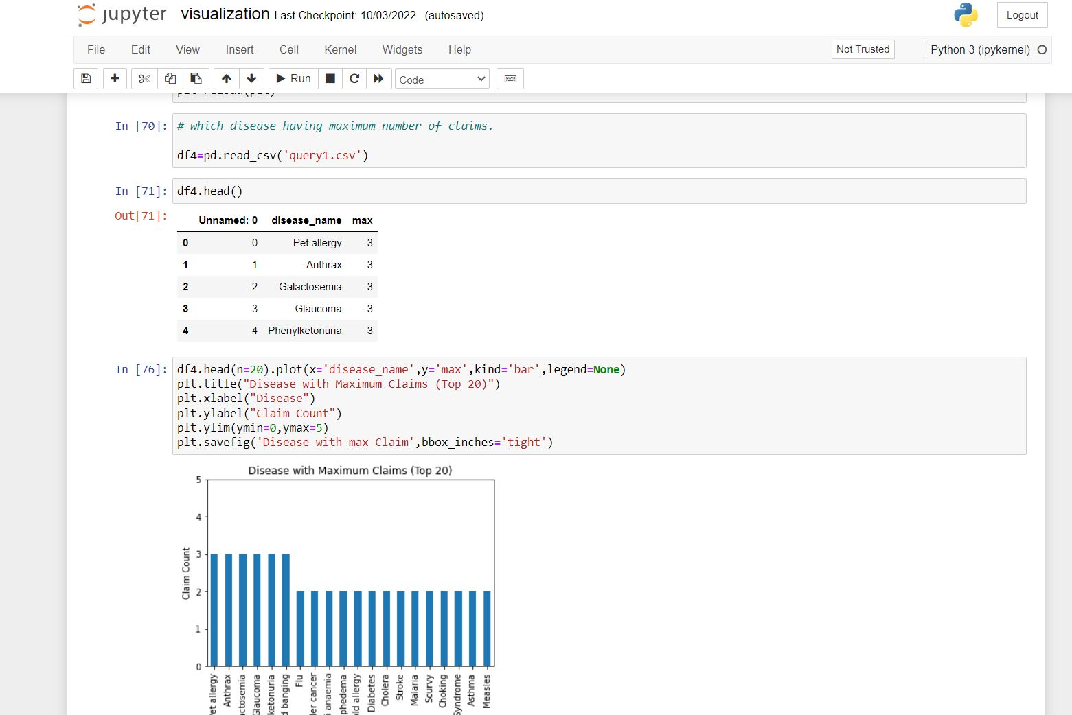
Visualizing query 1

Slide 16
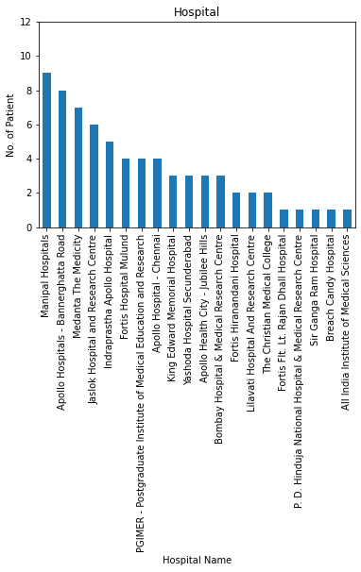
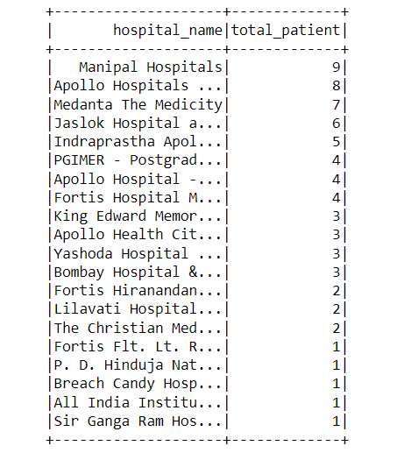
Visualization 1
Hospital serving with the most number of patients

Slide 17
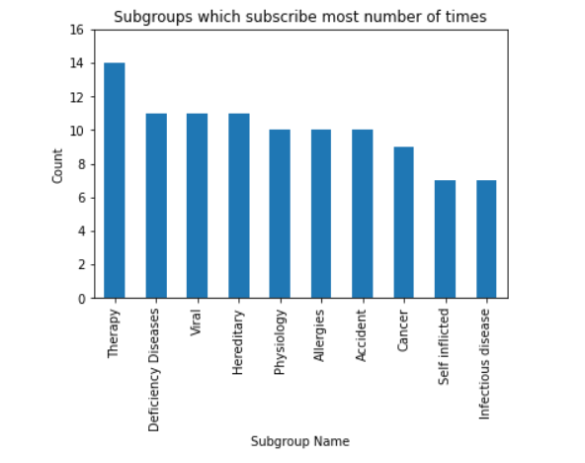
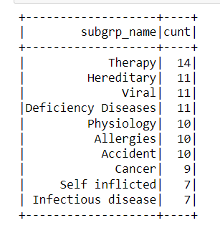
Visualization 2
Subgroups that subscribe for most number of times

Slide 18
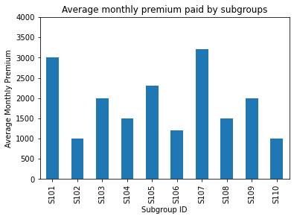
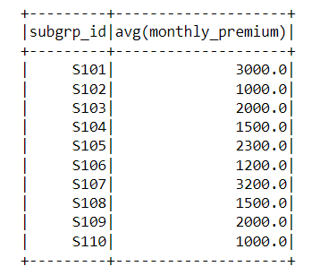
Visualization 3
Average monthly premium subscriber pay to insurance company subgroup.

Slide 19
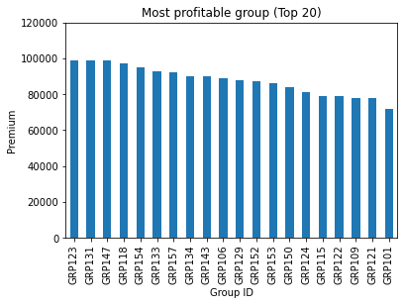
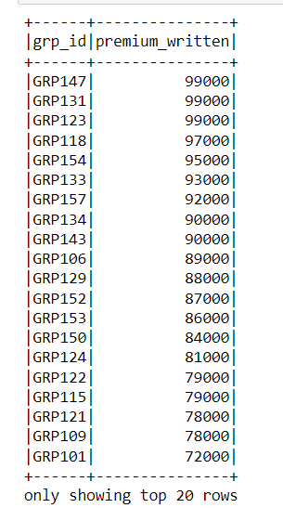
Visualization 4
Most profitable group

Slide 20
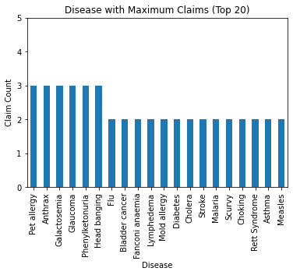
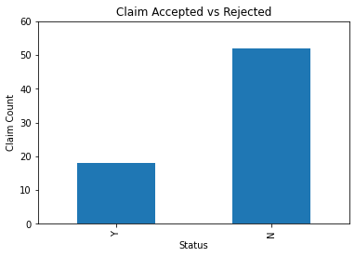
Visualization 5
disease having maximum number of claims
Claims accepted vs rejected

Slide 21
Insights gained
From these visualizations we can gain insights such as the subgroups that provide profit to the Insurance companies, the hospitals that serve more patients, the diseases having more claims, and many others.
From which the customers can make decisions in terms of opting for the best insurance policy, hospitals, and others.
The healthcare systems also get to make business decisions in terms of providing benefits and attracting groups or patients that are not involved in any insurance policies before.

Slide 22
References
[1] Tableau. Guide To Data Cleaning: Definition, Benefits, Components, And How To Clean Your Data
https://www.tableau.com/learn/articles/what-is-data-cleaning
[2] IBM Cloud Education (2020, 28 April). ETL (Extract, Transform, Load)
https://www.ibm.com/cloud/learn/etl
[3] Karin Kelly (2022, Nov 29). What is Data Analysis? Methods, Process and Types Explained
https://www.simplilearn.com/data-analysis-methods-process-types-article
[4] IBM Cloud Education (2021, 10 February). Data Visualization.
https://www.ibm.com/cloud/learn/data-visualization

